Slide 1
Theories of exchange rate determination

Slide 2
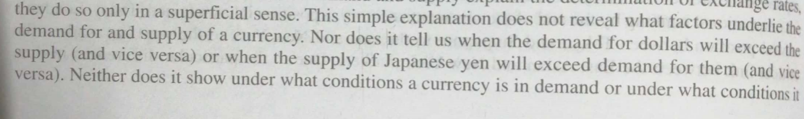
introduction
At the most basic level, exchange rates are determined by demand and supply of one currency relative to the demand and supply of another.
However differences in relative demand and supply explain the determination of exchange rates, they do it only in a superficial sense.

Slide 3
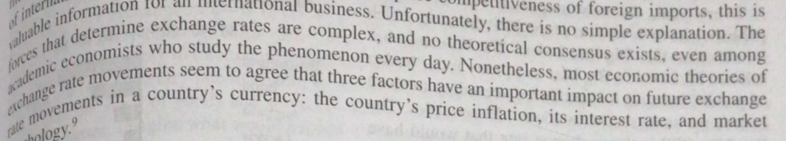
introduction

Slide 4
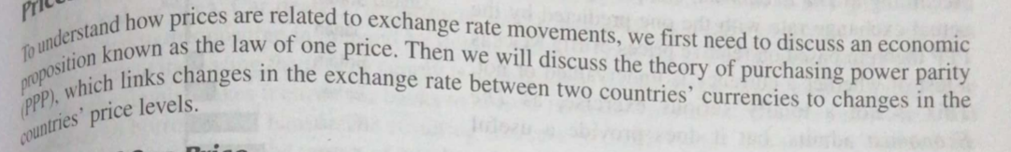
Prices and exchange rates

Slide 5
Law of one price
The law of one price states that in competitive markets free of transportation costs and barriers to trade, identical products sold in different countries must sell for the same price when their price is expressed in terms of the same currency.
For example: 1£=$2
A jacket that retails for $80 in New York should sell for £40 in London.
Consider what would happen if the jacket is selling for £30 in London (which should be then in this case according to the ER be selling at $60 in New York, but this does not happen)
ARBITRAGE!!!

Slide 6
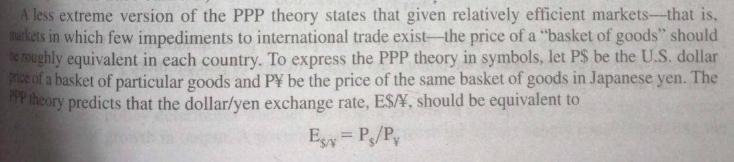
Purchasing power parity (PPP)-absolute
If the law of one price were true for all goods and services, the PPP exchange rate could be found from any individual set of prices.
By comparing the prices of identical products in different currencies, it would be possible to determine the real or PPP exchange rate that would exist if markets were efficient.

Slide 7
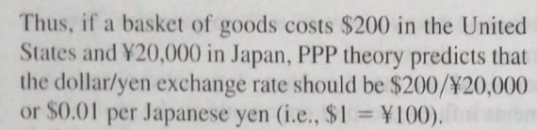
Ppp-example

Slide 8
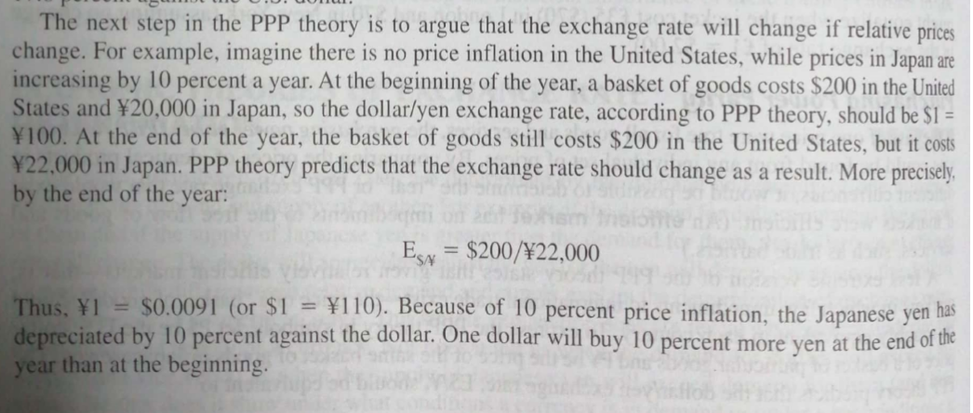
Purchasing power parity (PPP)-relative

Slide 9
Purchasing power parity (PPP)-relative
Thus, PPP theory predicts that exchange rates are determined by relative prices and that changes in relative prices will result in a change in exchange rates.

Slide 10
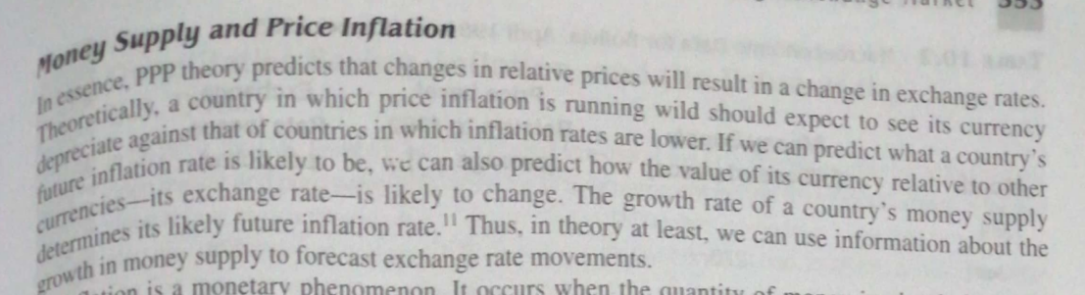
Money supply and price inflation

Slide 11
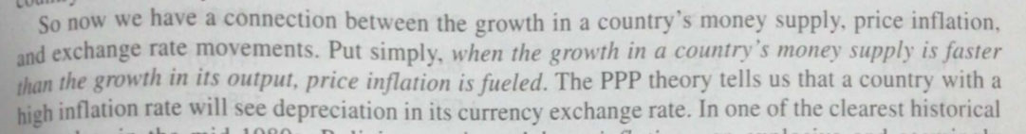
Money supply and price inflation

Slide 12
Evaluation of PPP theory
Empirically, Holds true in long-run but not a strong predictor of short term movements in ER
Better prediction for underdeveloped capital markets but less useful in predicting in case of advanced industrialised nations
Assumes away transportation costs and barriers to trade
The demand is not always identical, differentiation in products is an important factor leading to price discrimination
Governments also intervene in foreign exchange markets
Impact of investor psychology and other factors in price determination weakens PPP

Slide 13
Interest rate parity (IRP) theory
IRP theory is a theory that suggests a strong relationship between interest rates and the movement of currency values.
It suggests that future exchange rates will be dependent upon the differences in interest rate in two countries.

Slide 14
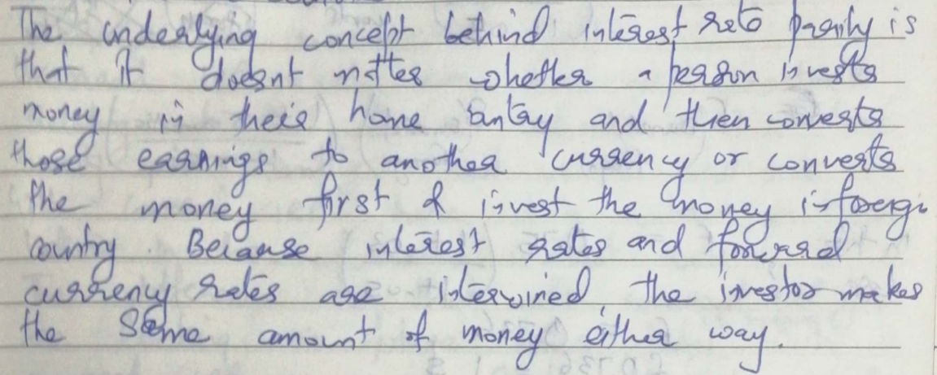
Interest rate parity (IRP) theory

Slide 15
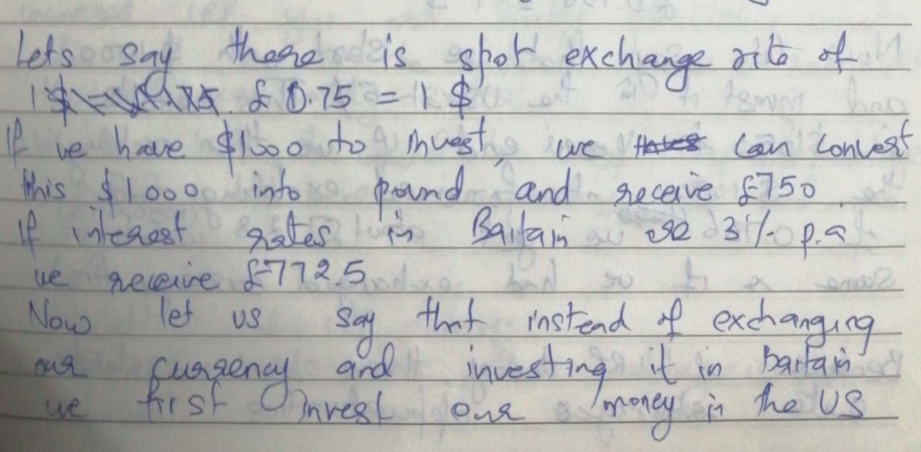
Interest rate parity (IRP) theory-example

Slide 16
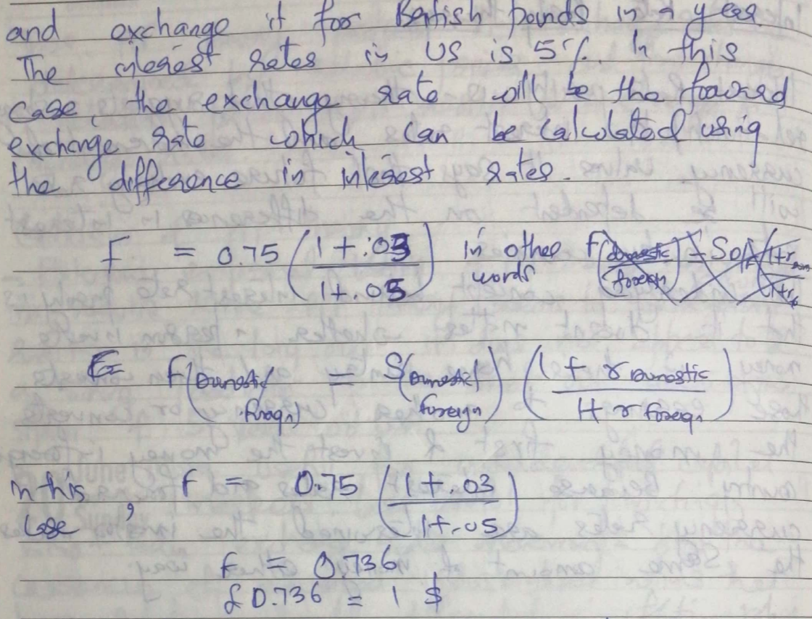
Interest rate parity (IRP) theory-example

Slide 17
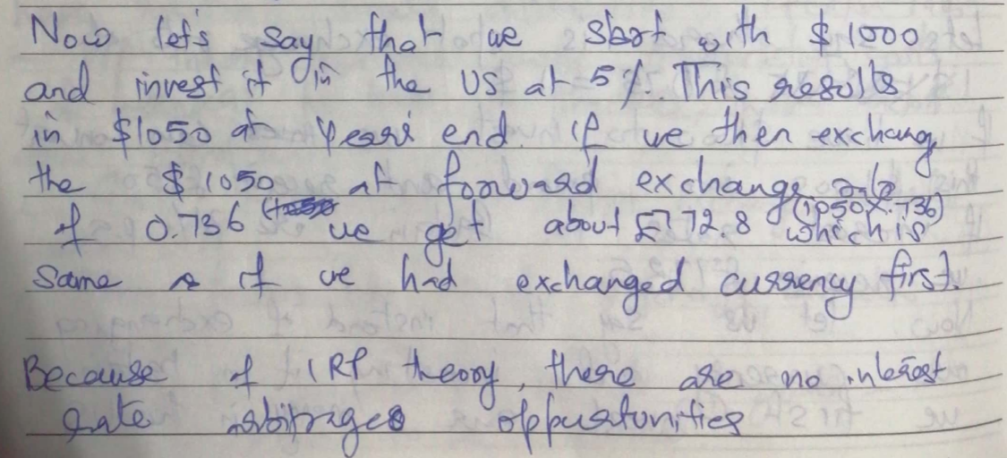
Interest rate parity (IRP) theory-example

Slide 18

Interest rate parity (IRP) theory

Slide 19

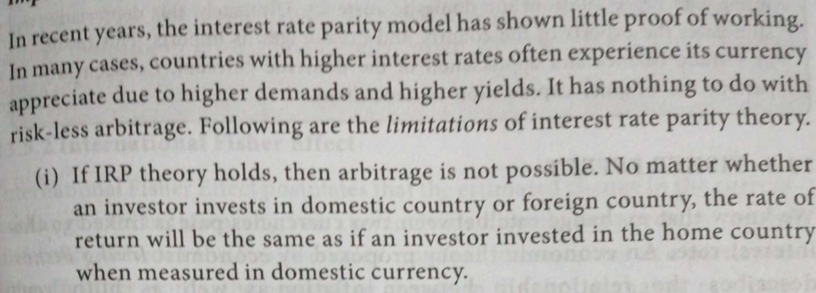
Interest rate parity (IRP) theory-implications

Slide 20
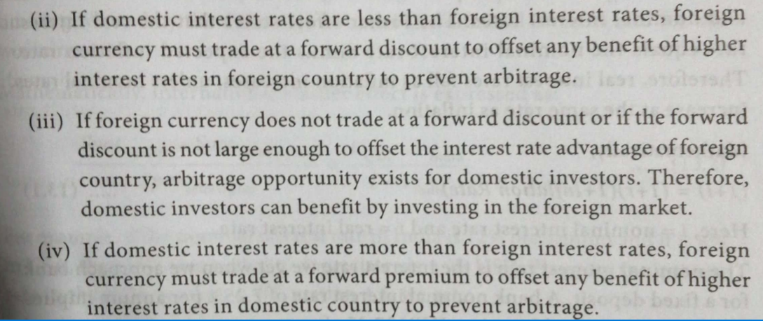
Interest rate parity (IRP) theory-implications

Slide 21
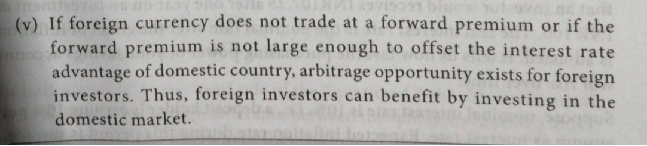
Interest rate parity (IRP) theory-implications

Slide 22
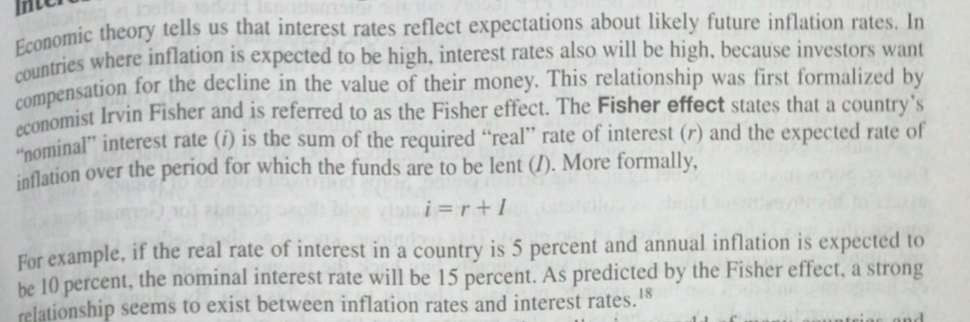
Fischer effect

Slide 23
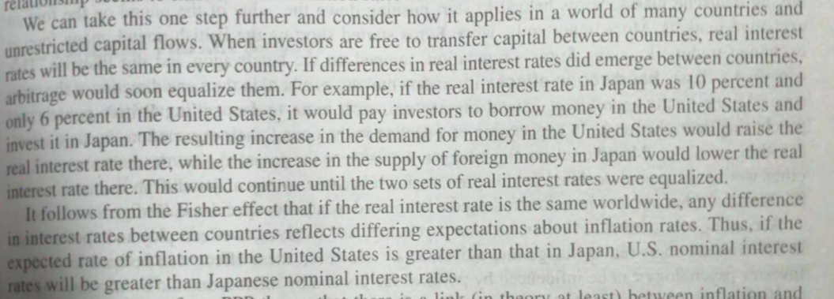
Fischer effect

Slide 24
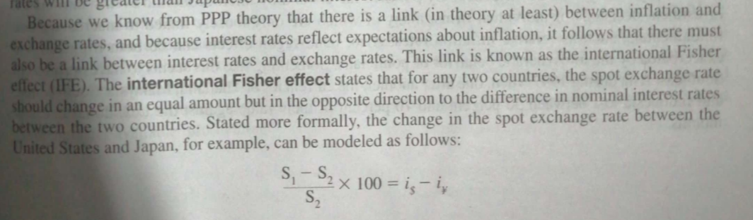
Fischer effect

Slide 25
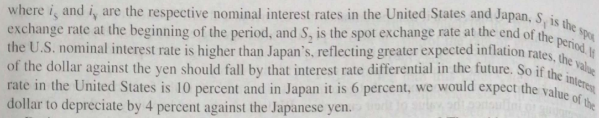
Fischer effect

Slide 26
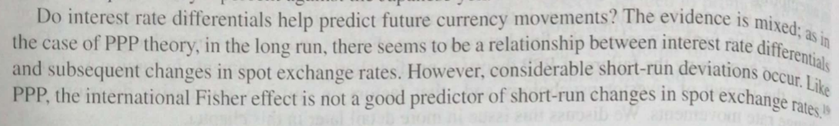
Fischer effect

Slide 27
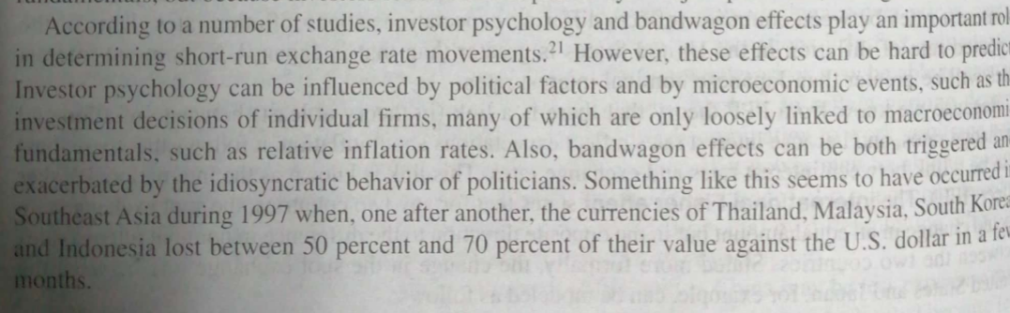
Investor Psychology and bandwagon effect

